Slide 1
PL-600 Application Lifecycle Management (ALM)

Slide 2
Agenda
Microsoft vision and Solution Architect’s role in ALM
Environment strategies
Defining a solution structure for your deliverable

Slide 3
Solution Architect role in ALM
Lead the establishment of an application lifecycle management (ALM) plan
Evaluate and determine the amount and sophistication of the ALM that is appropriate for the project
Work with the various teams to support their efforts to implement the and execute the plan

Slide 4
Microsoft Power Platform vision for ALM
Quick Start: Enable app builders to get set up with an environment with the latest build and connected to source control and make a change quickly
Build: Simplify tooling, consolidate portals and speed up inner loop
Deploy: Enable an automated repeatable (predictable) deployment methodology
Manage: Invest in additional environment management capabilities to offer more flexibility for app builders to use and dispose preconfigured environments as needed
Monitor: Application telemetry and feedback loop by design
Notes:
Solution Architects should understand the vision and journey Microsoft is on to shape how ALM is done for Microsoft Power Platform projects. As this journey evolves, Solution Architects should continue to shape their own plans to leverage the capabilities provided by the platform and tools.
Inner Loop – the iterative process that an app builder performs when creating an app and its components and local testing before sharing with the broader team

Slide 5
Key Solution Architect ALM considerations
Environment Strategy – How many, what’s their purpose
Source Control – Where will the master copy of the solutions and code live
DevOps – What is the workflow for app builders and how/who will promote the app on its journey from dev to production
Deployment Configuration – How to configure each environment and what can be done to make this easier
Notes:
This includes helping the organization put in place proper governance for the solution

Slide 6
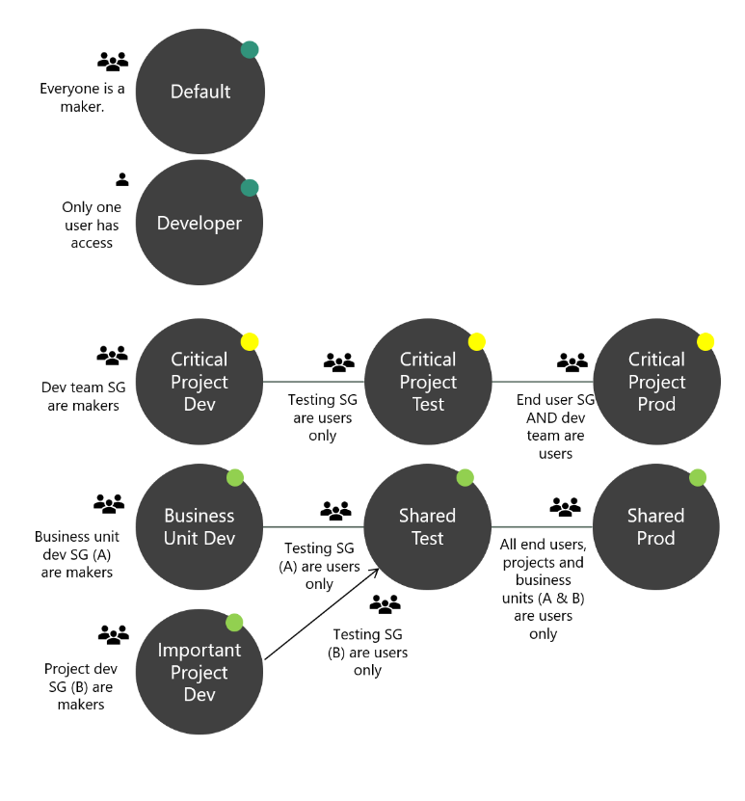
Developing an Environment Strategy
This can be organization wide if not already one in place
This can be project specific to support your team and project deployment
Notes:
Talk through Default and Developer – these typically won’t be in consideration for a project a Solution Architect is involved with. They will most likely be building using the critical project path of dev,test , production or dedicated dev and shared test/prod

Slide 7
Environment vs. source control master copy
Environment centric
The dev environment is the master copy of all changes
Changes promote directly from Dev -> Test->Prod
Source control centric
Source control is the master
Dev is re-created from source control (this can be automated and repeatable)
Changes from dev are checked into source control
Microsoft is encouraging and building tooling to support source control centric ALM
Notes:
Traditionally, Microsoft Power Platform projects have been more environment centric and many are moving towards Source Control centric
Source control centric encourage having a definitive master and ability to re-create development environments for any version tracked
Ideally all environments other than production should be 'throw away' - that is they can be deleted and recreated without any loss

Slide 8
Solutions Overview
Solutions are a container to track the changes you make to the Common Data Service, Power Apps and Power Automate flows
Solutions are how you transport and install changes to target environments
Microsoft Dynamics 365 apps are installed using solutions
3rd party apps provided by Independent Software Vendors (ISVs) also use solutions
Development
Test
Production
Notes:
Solutions are containers that track and manage customizations in a CDS environment
If you have multiple environments, each would have their own set of solutions. Solutions can include entity metadata, forms, views, business rules, processes definitions and other assets required to run the app; including components created by developers like scripts or compiled code.
when you have a Dynamics 365 application like Sales or Service those are installed using the same solution framework. 3rd party ISVs also ship their products using solutions

Slide 9
Types of Solutions
Unmanaged
Managed
Used during development
Used to transport to other development environments
Used to distribute to non-development environments
Notes:
Unmanaged Solutions are to be used in development environments while you are making configuration changes to your application. Solutions are exported as unmanaged and checked into your source control system. Unmanaged solutions should be considered your source.
Managed solutions are used to deploy to any environment outside of development. This includes test, UAT, SIT, and production environments. Managed solutions should be generated by a build server and considered as a build artifact.

Slide 10
Solution Layering
Layering occurs on import of managed solutions
Layers describe the dependency chain of component from the root solution introducing it, through each solution that extends or changes the component’s behavior
Layers are created through extension of an existing component (taking a dependency on it) or through creation of a new component or version of a solution.
Application Behaviour
What the user sees
Unmanaged “layer”
Unmanaged Customizations
Unmanaged Solution C
Unmanaged Solution D
Managed Layers
1 per managed solution
Managed Solutions
Managed Solution B
Managed Solution A
System Layer* CDS Managed Layer
System Solution*
Base CDS entities

Slide 11
Solution Layering
Device Inventory App
Care Kudos App
What the apps and users see
Contoso Common
CDM Healthcare Extension
CDM/System Entities
Notes:
Solutions are layered. E.g. the contact form is customized in the CDM Healthcare Extension. The same form elements are modified in the Contoso Common solution. The end users will see the changes from the Contoso Common solution.

Slide 12
Deciding on one or more solutions
Use multiple solutions only for a tangible purpose, multiple solutions add complexity
Common patterns for multiple solution splitting is horizontal and vertical partitioning
Multiple solutions each require their own environments to ensure they remain independent
Care must be taken to manage dependencies
Teams must know what solution to put new components in

Slide 13
Example of Horizontal Solution Splitting
Visual Components
Processes & Plugins
Reports
Security Roles
Main
Apps
Canvas Components
PCF Components
Web Resources
Processes
Plug-in Assemblies
SDK Message Processing Steps
Reports
Security Roles
Entities
Option Sets
Client Extensions
Service Endpoints
Dashboards
Connection Roles
Article Templates
Email Templates
Mail Merge Templates
Field Security Profiles
Notes:
Can be all or some of these, but it should be for a purpose.
Care must be taken to ensure it doesn’t create a web of dependencies

Slide 14
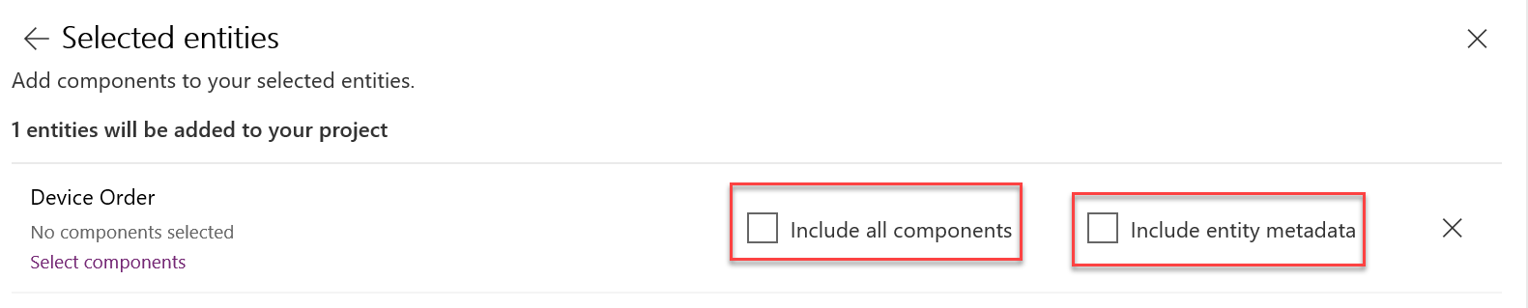
Include only the minimum components
Avoid using include all components unless adding in an unmanaged entity
Include entity metadata only when you are changing entity properties
Add subcomponents of entity (fields, forms, views etc.) only when you are changing them
Notes:
Often referred to as solution segmentation reduces the footprint of the solution to reduce change of collision as well as improves time to import/export. This also reduces unnecessary dependencies.
If too many entity sub components are included, you can remove the entity from the solution and re-add with only the minimal needed

Slide 15
Updating Existing Managed Solutions – Import Options
Update – Applies changes, no removal of items occur, can’t be used if any patches in place
Upgrade – Default option, imports changes and applies them immediately including removing components not in new solution, old solution and any patches are removed
Stage for Upgrade – Similar to upgrade but it pauses after new solution is imported before removing components so you can do data migration etc. and then manually trigger the final apply of the solution

Slide 16
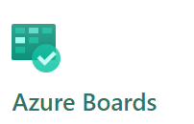
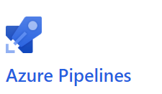
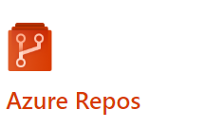
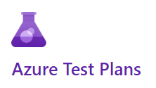
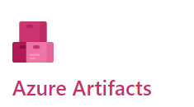
Azure Dev Ops
Notes:
Trainer- consider a demo here, many students have never done this before
Azure Boards - plan, track, and discuss work across your teams
Azure Pipelines – Use to automate CI/CD builds and releases
Azure Repos – Source Control to store and track changes
Azure Test Plans - Plan, execute, and track scripted tests
Azure Artifacts – publish solutions built by build pipelines

Slide 17
Using Azure Pipelines
Build pipelines can be used to
Create dev environments
Commit changes from dev to source control
Solution Checker
Automated Testing
To build output solutions from source control (e.g. managed/unmanaged)
Release pipelines can be used to
Take solutions from build pipelines and deploy them to one or more test/prod environments
Perform automated testing as part of release process
Pause for approvals before progressing to next environment

Slide 18



ALM Powered by Azure DevOps
Initiate
Build
Release
Getting started, faster
Build and Walk away
Automated, Predictive, Repeatable
Provision
Environment
Deploy
Dependencies
Pack Source
Code from
Repo
Import
Solution
Run Unit Test
Run Solution
Checker
Export
Solution
Unpack to
Repo
Run Unit Test
Pack Solution
Run Solution
Checker
Run
Integration
Test
Import as
unmanaged
Increment
Version
Export
Managed
Initial Build Pipeline instantiates pristine Development Environment daily
Build Pipeline Automates manual steps.
No more upload to Solution checker and
manually export solution, unpack and
push to repo
Automated Release Pipeline removes manual steps. Weekly, daily or hourly releases becomes the new standard
Powered by Azure DevOps
Notes:
This would be a good place for the instructor to show in Azure Dev Ops the tasks and talk through them

Slide 19
Deployment Checklist
Proper environment access has been established e.g. Security Groups
Data loss prevention policies are correct for solution environments
Service Principals and service accounts necessary for connections are in place and configured after initial deploy
Environment settings have been documented and configured in each environment

Slide 20
Wrapping up
Establishing application lifecycle management process should be done at the start of the project
Having a repeatable process saves time and ensures consistent results
ALM is not a one size fits all, you must size it to fit your project

Slide 21
Hands on exercise: Application Lifecycle Management
Build pipeline
Test pipeline
Release to prod

